Slide 1

Audit report for Maui Jim B2B
05-02-2026

Slide 2
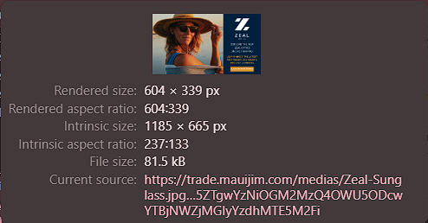
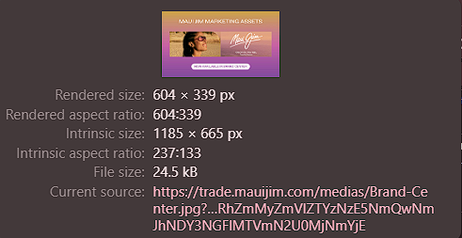
Images can be updated in size
The images used can be adjusted to fit to rendered size. This is mostly in the homepage carousel.
05-02-2026

Slide 3
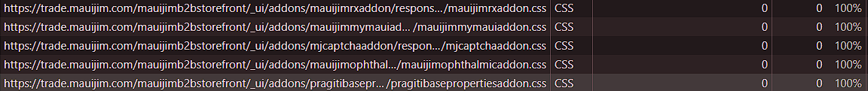
Unused & duplicate css/js files
A lot of places we have identical css & js files which are not even getting used when page loads. They can be removed or updated accordingly. Also, found in coverage a lot of these files are not getting used when page is loaded.
Lot of css/js files which are empty and can be removed.
05-02-2026

Slide 4
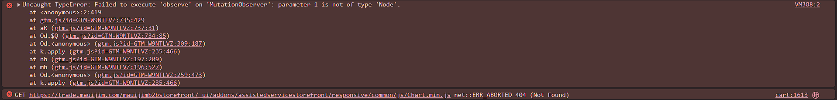
Errors in console
Console errors on cart page and all pages in general.
Need to remove all the files which are getting called and not present and fix the GTM error.
05-02-2026

Slide 5
Incorrect usage of “for” attributes in form
The label’s for attribute doesn’t match id in the form. This might prevent the browser from correctly autofilling the form and accessibility tools from working correctly.
05-02-2026

Slide 6
Call certain scripts and styles only on certain pages
We can call certain plugins only when needed on pages instead of everywhere
05-02-2026

Slide 7
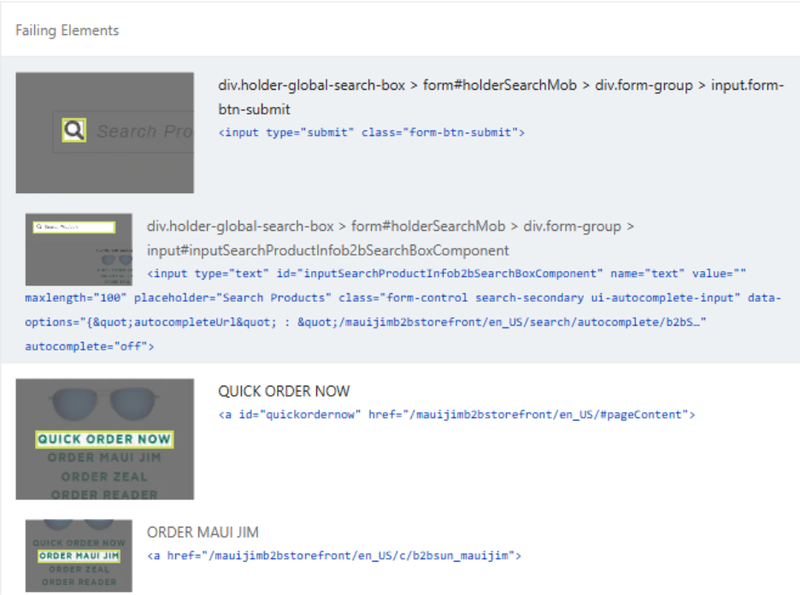
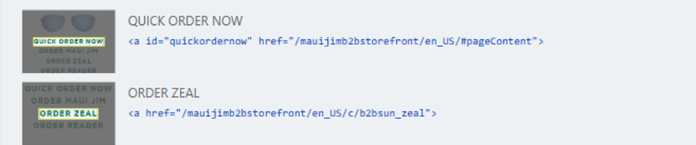

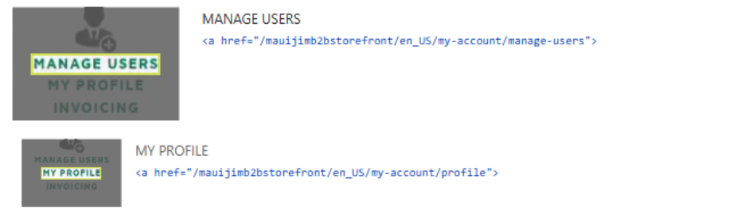
Touch target on mobile
Touch targets do not have sufficient size or spacing.
Minimum touch target size: 48 × 48 CSS pixels
05-02-2026

